Slide 1
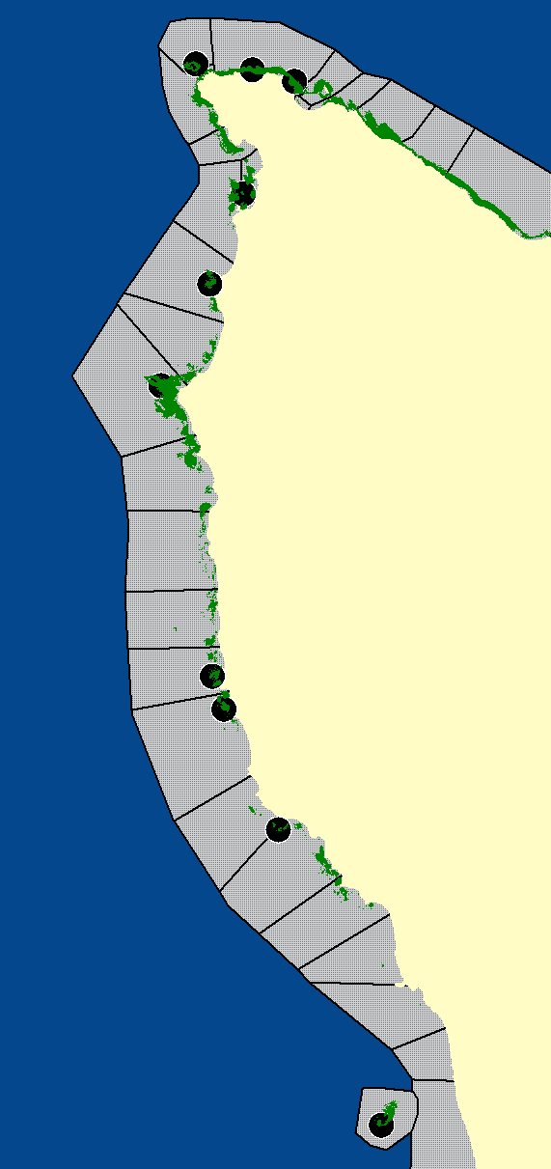

Slide 2
Otters

Slide 5
Kelp

Slide 6
Kelp

Slide 7
Kelp

Slide 8
Inverts

